Slide 1
Measuring Slow Ca²⁺ Dynamics in MIN6 Monolayers and Pseudoislets
Clayton Seitz, Scherer Lab

Slide 2
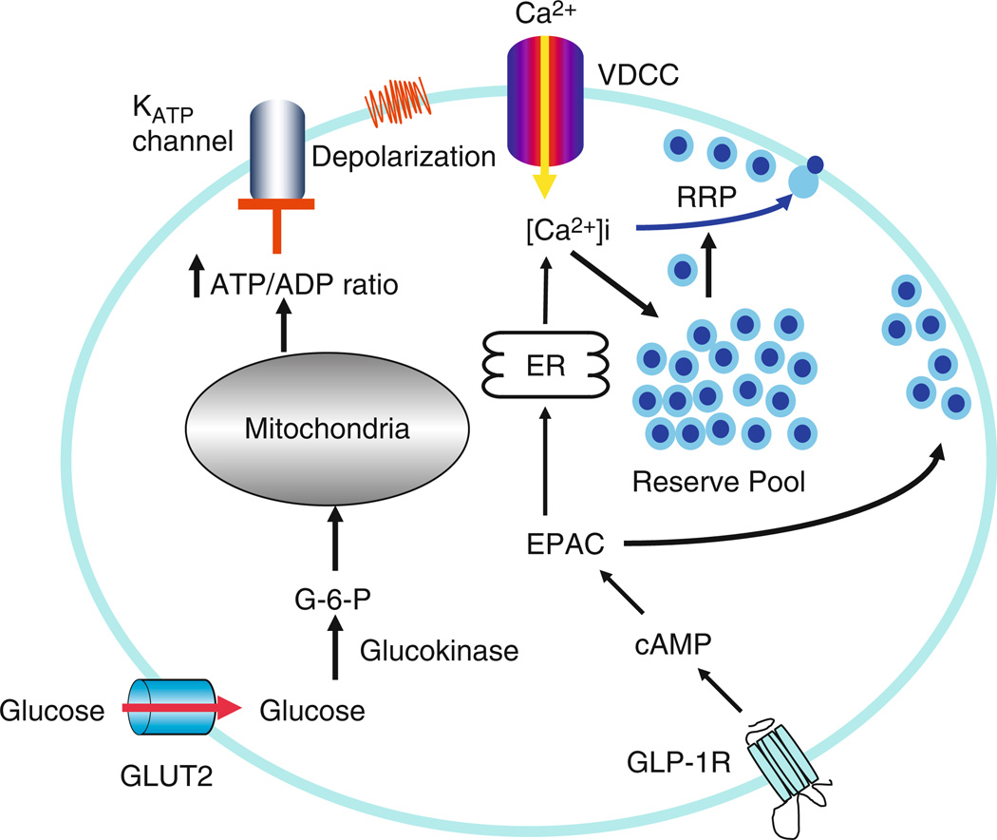
Intracellular Ca²⁺ is involved in Insulin Granule Exocytosis
ATP-sensitive K⁺ channels open and depolarize the cell
Elevated [Ca²⁺] triggers insulin granule exocytosis
Gap junctions allow cell-cell communication
Insulin Granule Biogenesis, Trafficking, and Exocytosis. Vitam Horm 2009

Slide 3
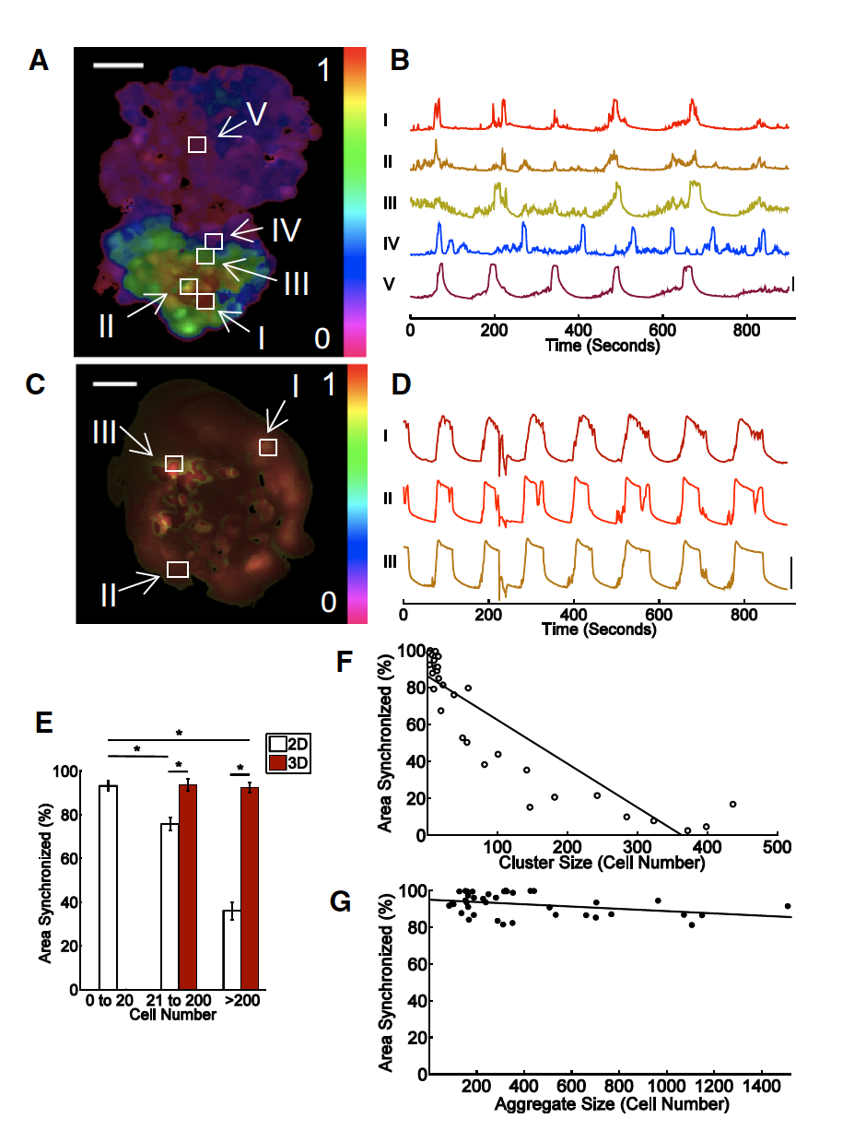
Synchronization of [Ca2+] oscillations is dependent on growth geometry
50um
[Ca2+] oscillations can be induced by incubation with glucose
[Ca2+] can be read out using a fluorescent calcium indicator
[Ca2+] oscillations are less synchronized in monolayers than pseudoislets
Monolayer
[Ca2+]
2D
3D
[Ca2+]
Pseudoislet
Monolayer
Pseudoislet
Dimensionality and size scaling of coordinated Ca2+ dynamics in MIN6 beta-cell clusters. Biophysical Journal. 2014
Notes:
3

Slide 4
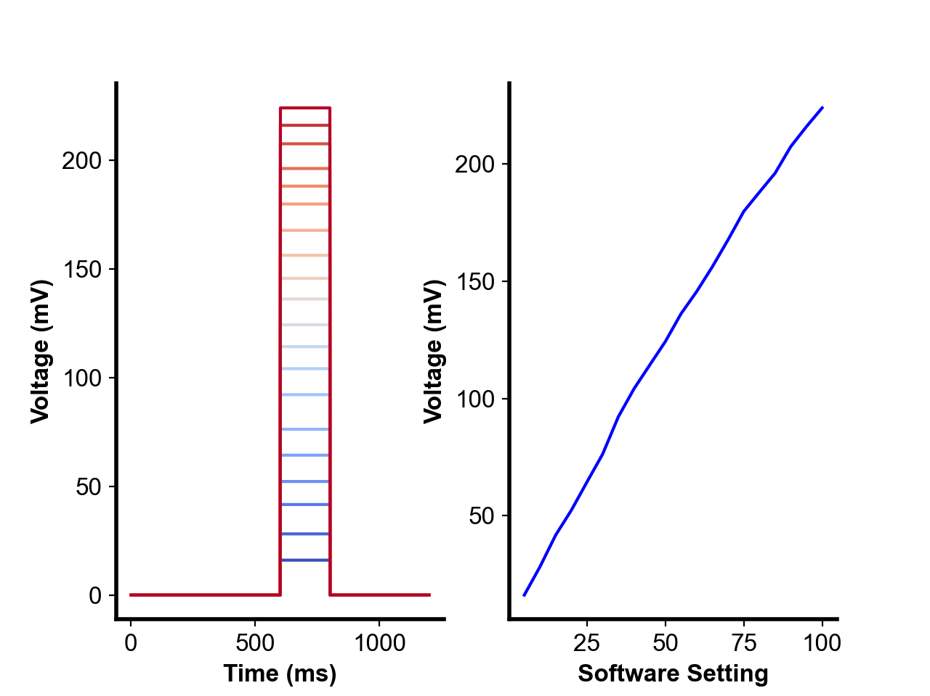

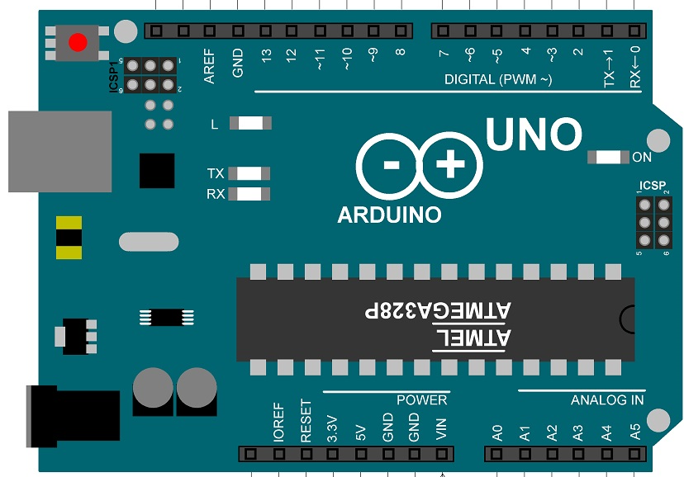
Photobleaching Imposes Constraints on Observable [Ca2+] Dynamics
PD
[Ca2+] calcium indicators have a finite photon budget before photobleaching
Widefield LED excitation promotes photobleaching
Photobleaching can be mitigated with timing/intensity control
TTL - Transistor-Transistor Logic
PD - Photodiode
CMOS – Complementary metal oxide semiconductor
60X Water
LED
UNO TTL
READOUT
Detector
CMOS TTL

Slide 5
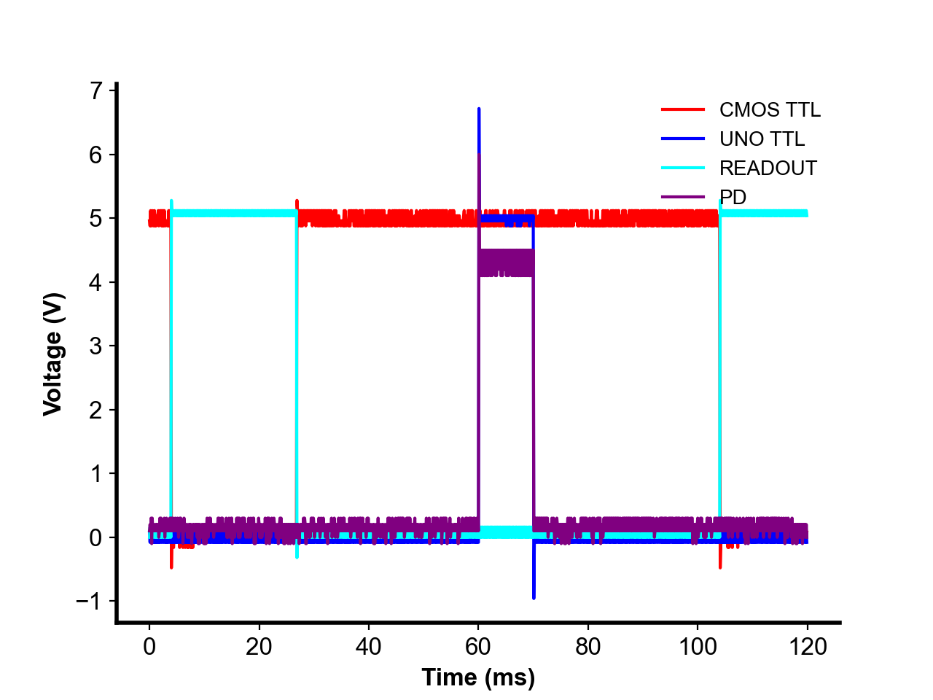
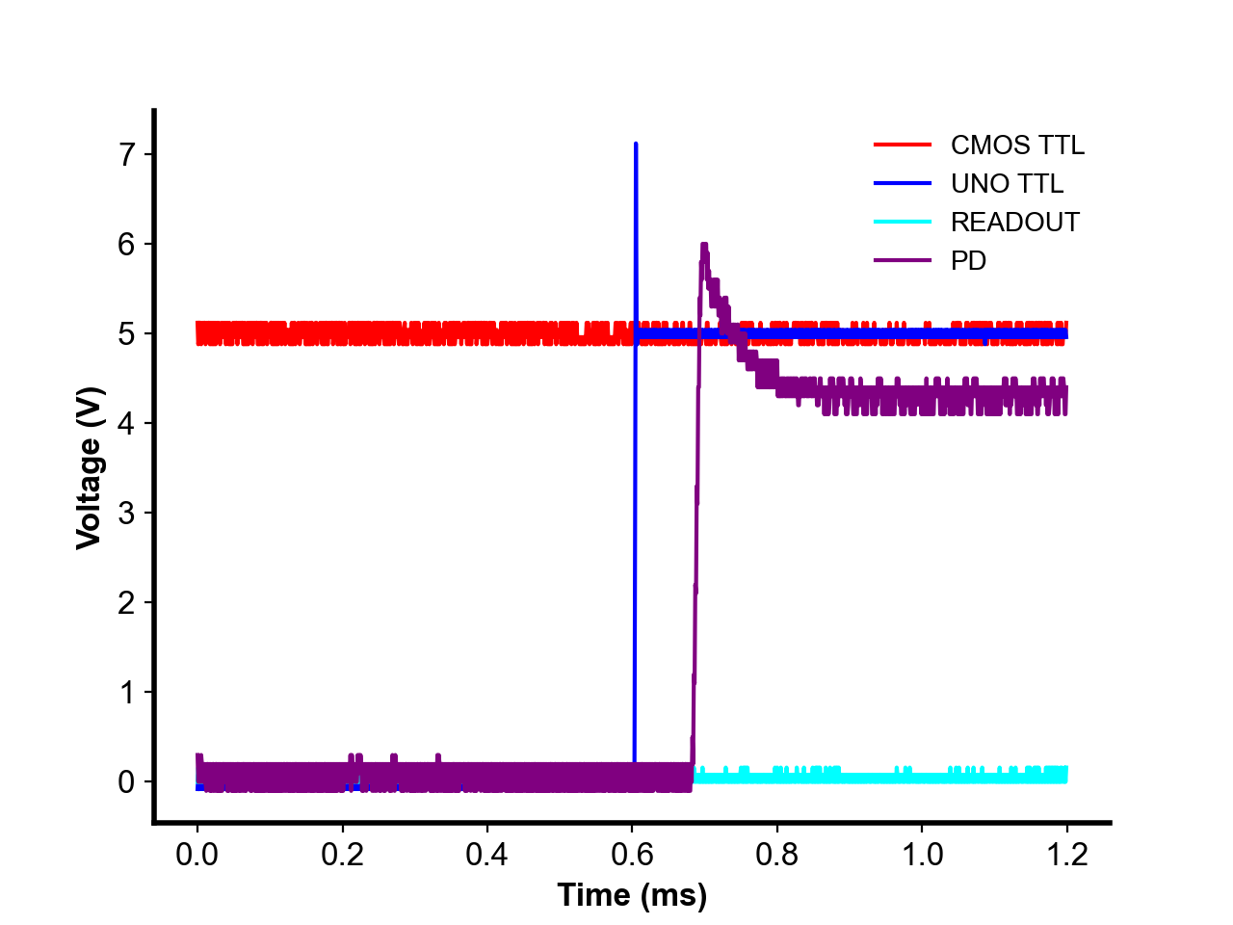
Transistor-Transistor Logic (TTL) Allows Precisely-Timed Pulsatile Excitation
Brief excitatory pulses during sensor exposure limits photobleaching at low frame rates

Slide 6
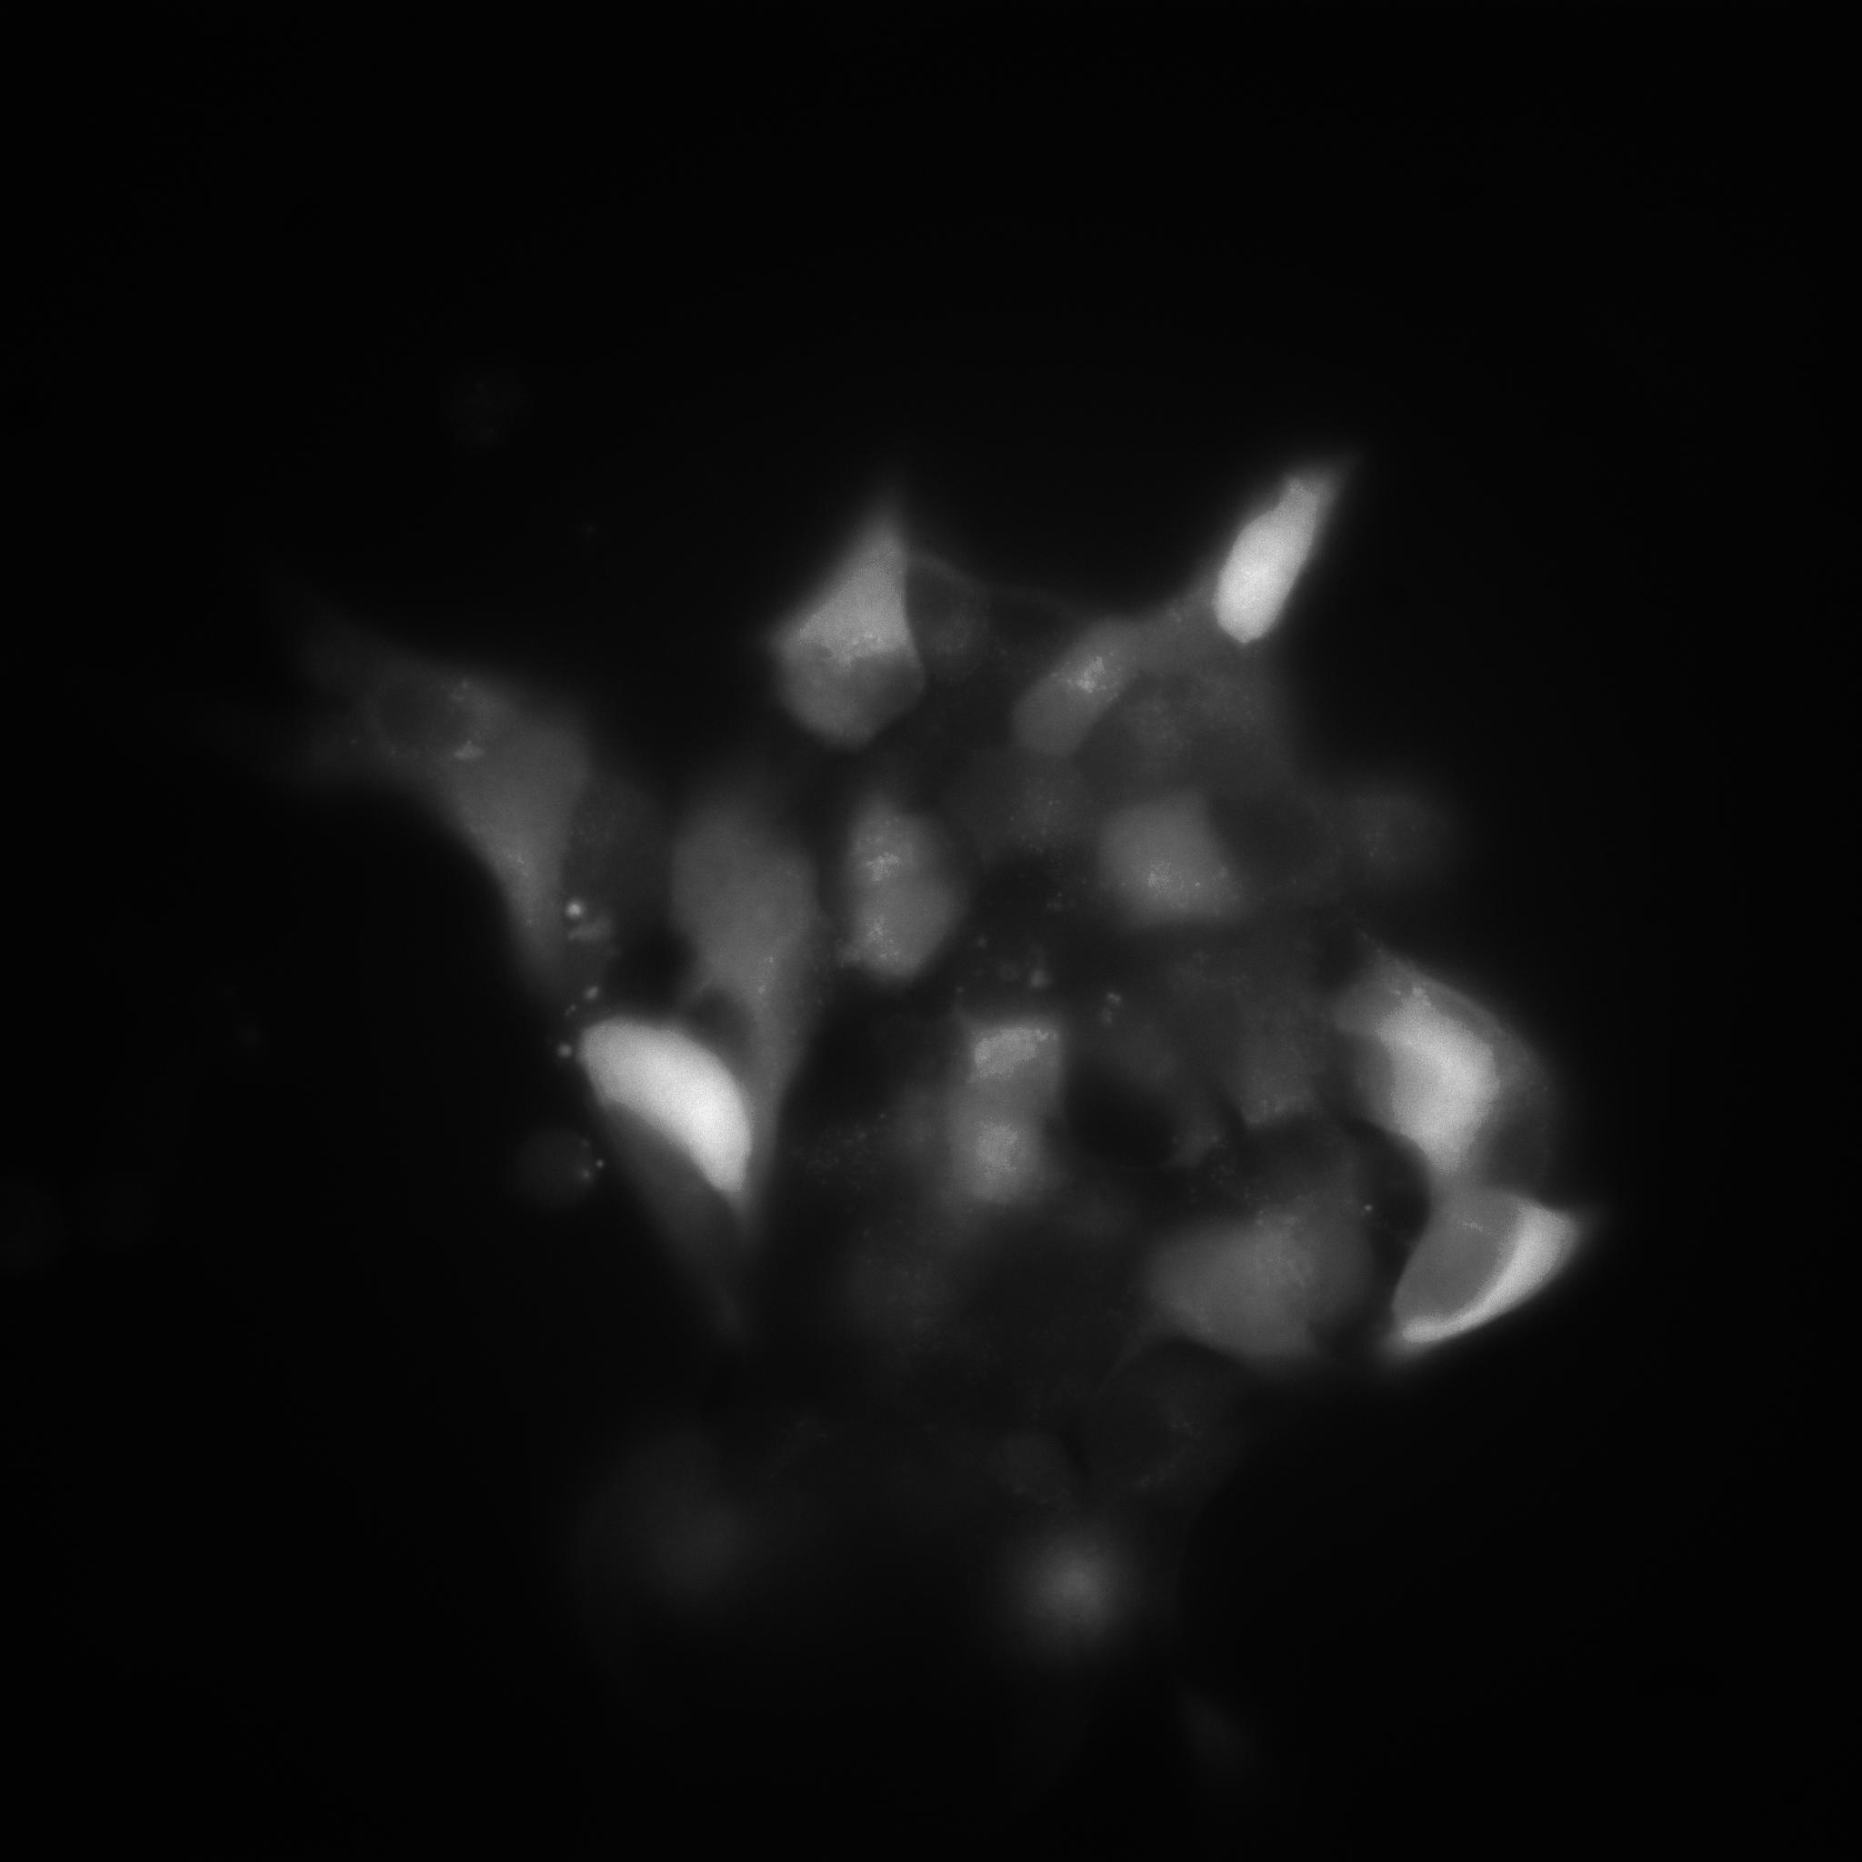
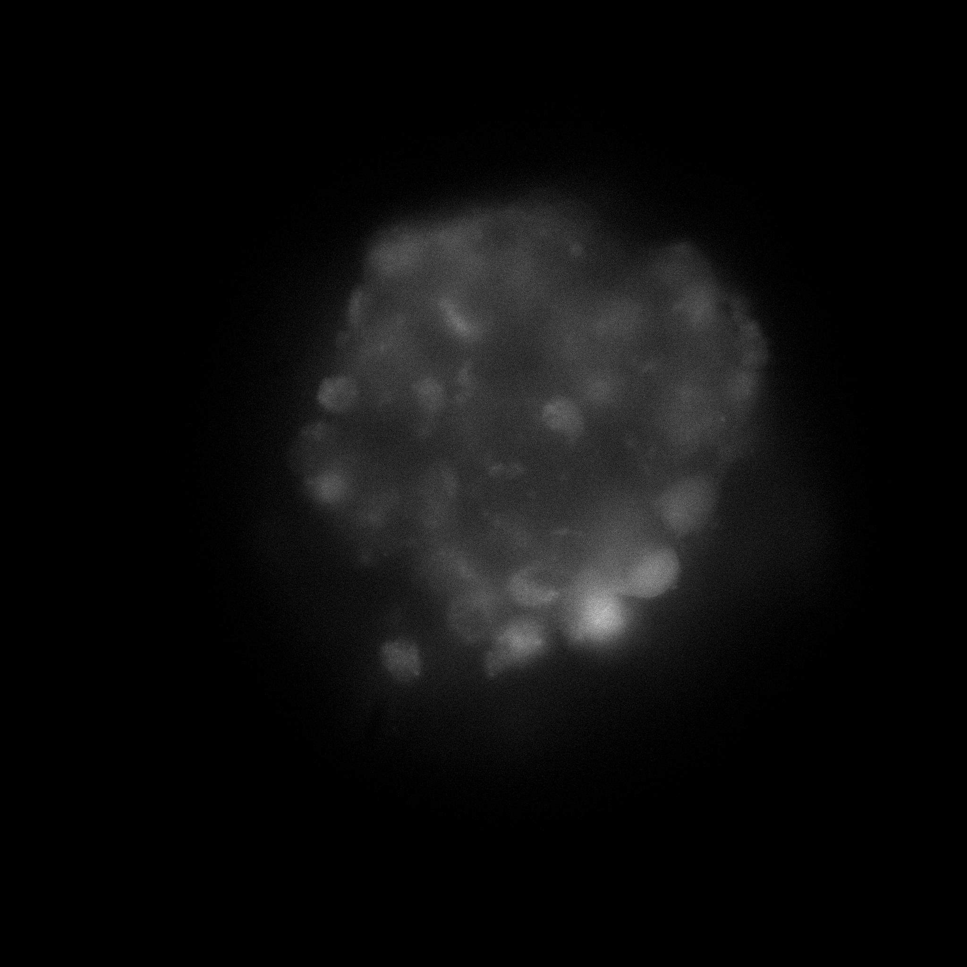
MIN6 Monolayer/Pseudoislet at 28mM Glucose
Monolayer
Pseudoislet

Slide 7
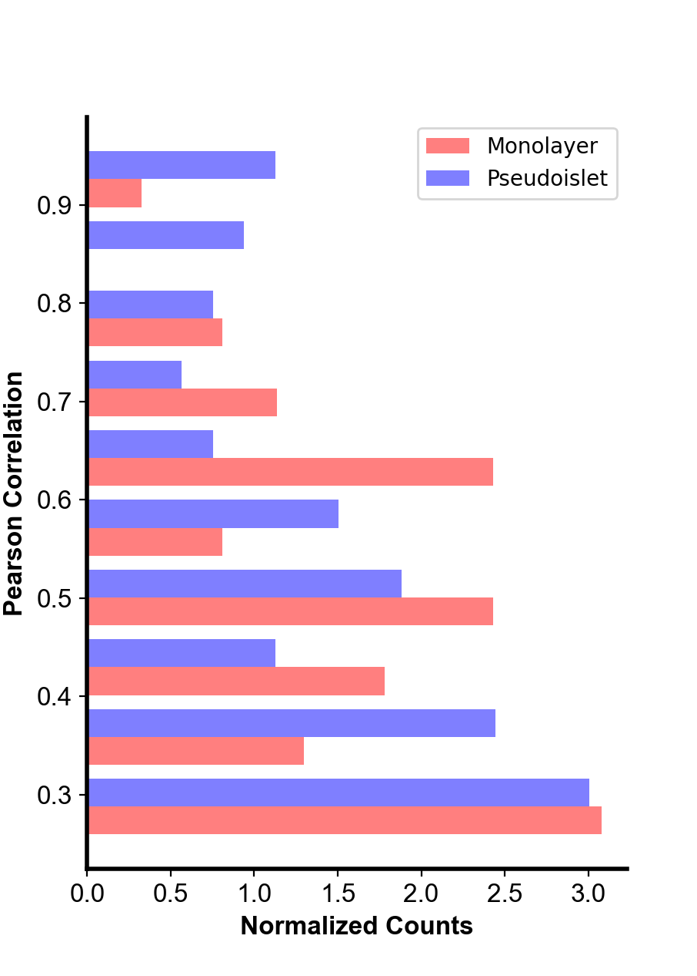
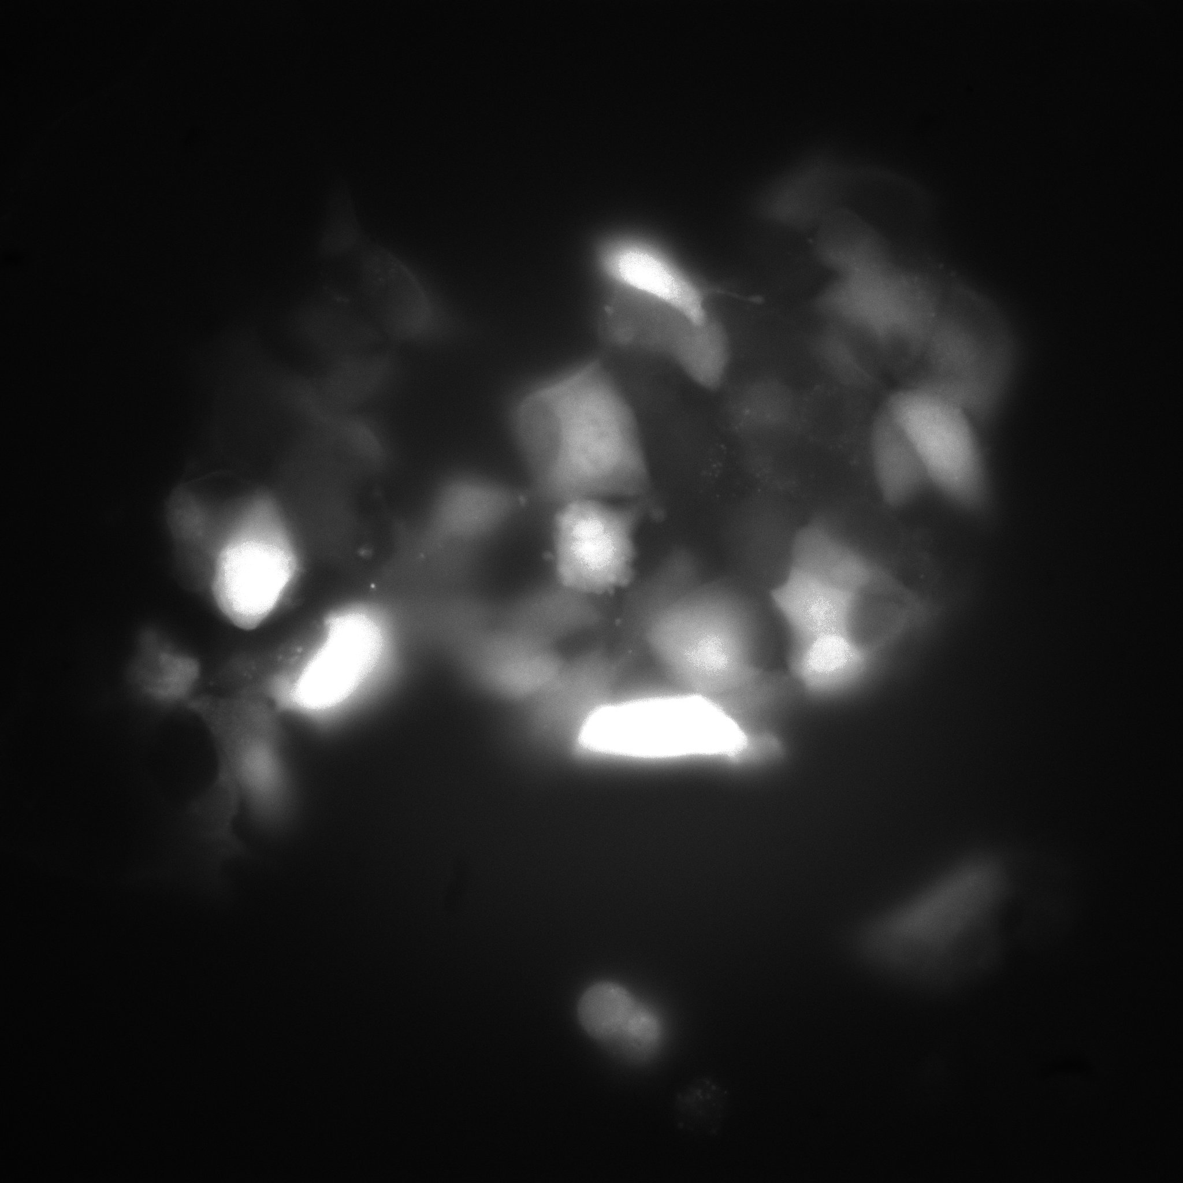
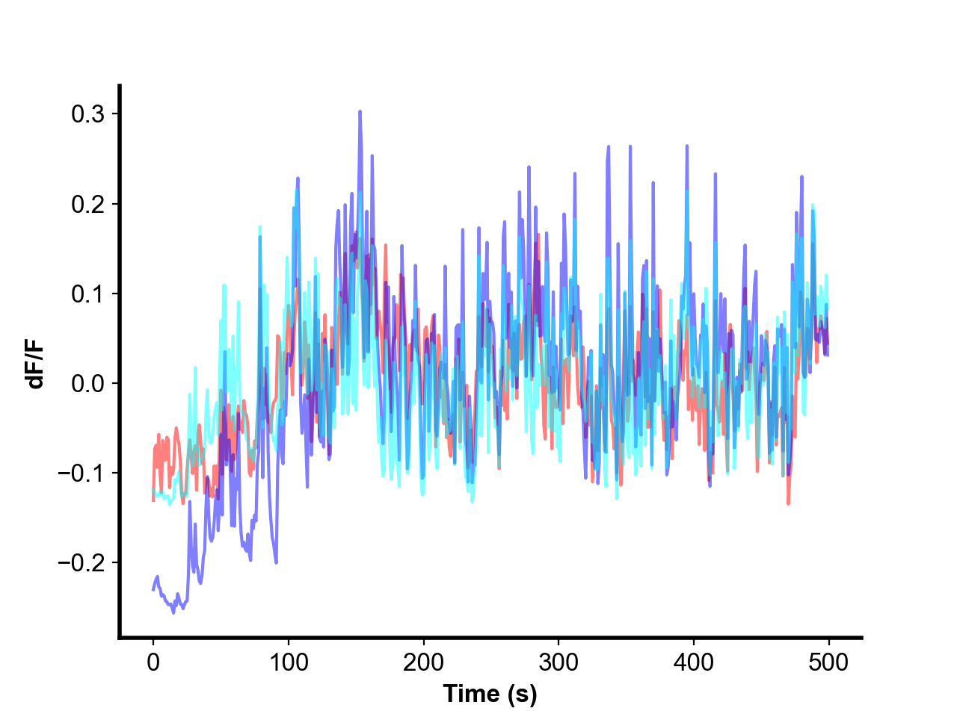
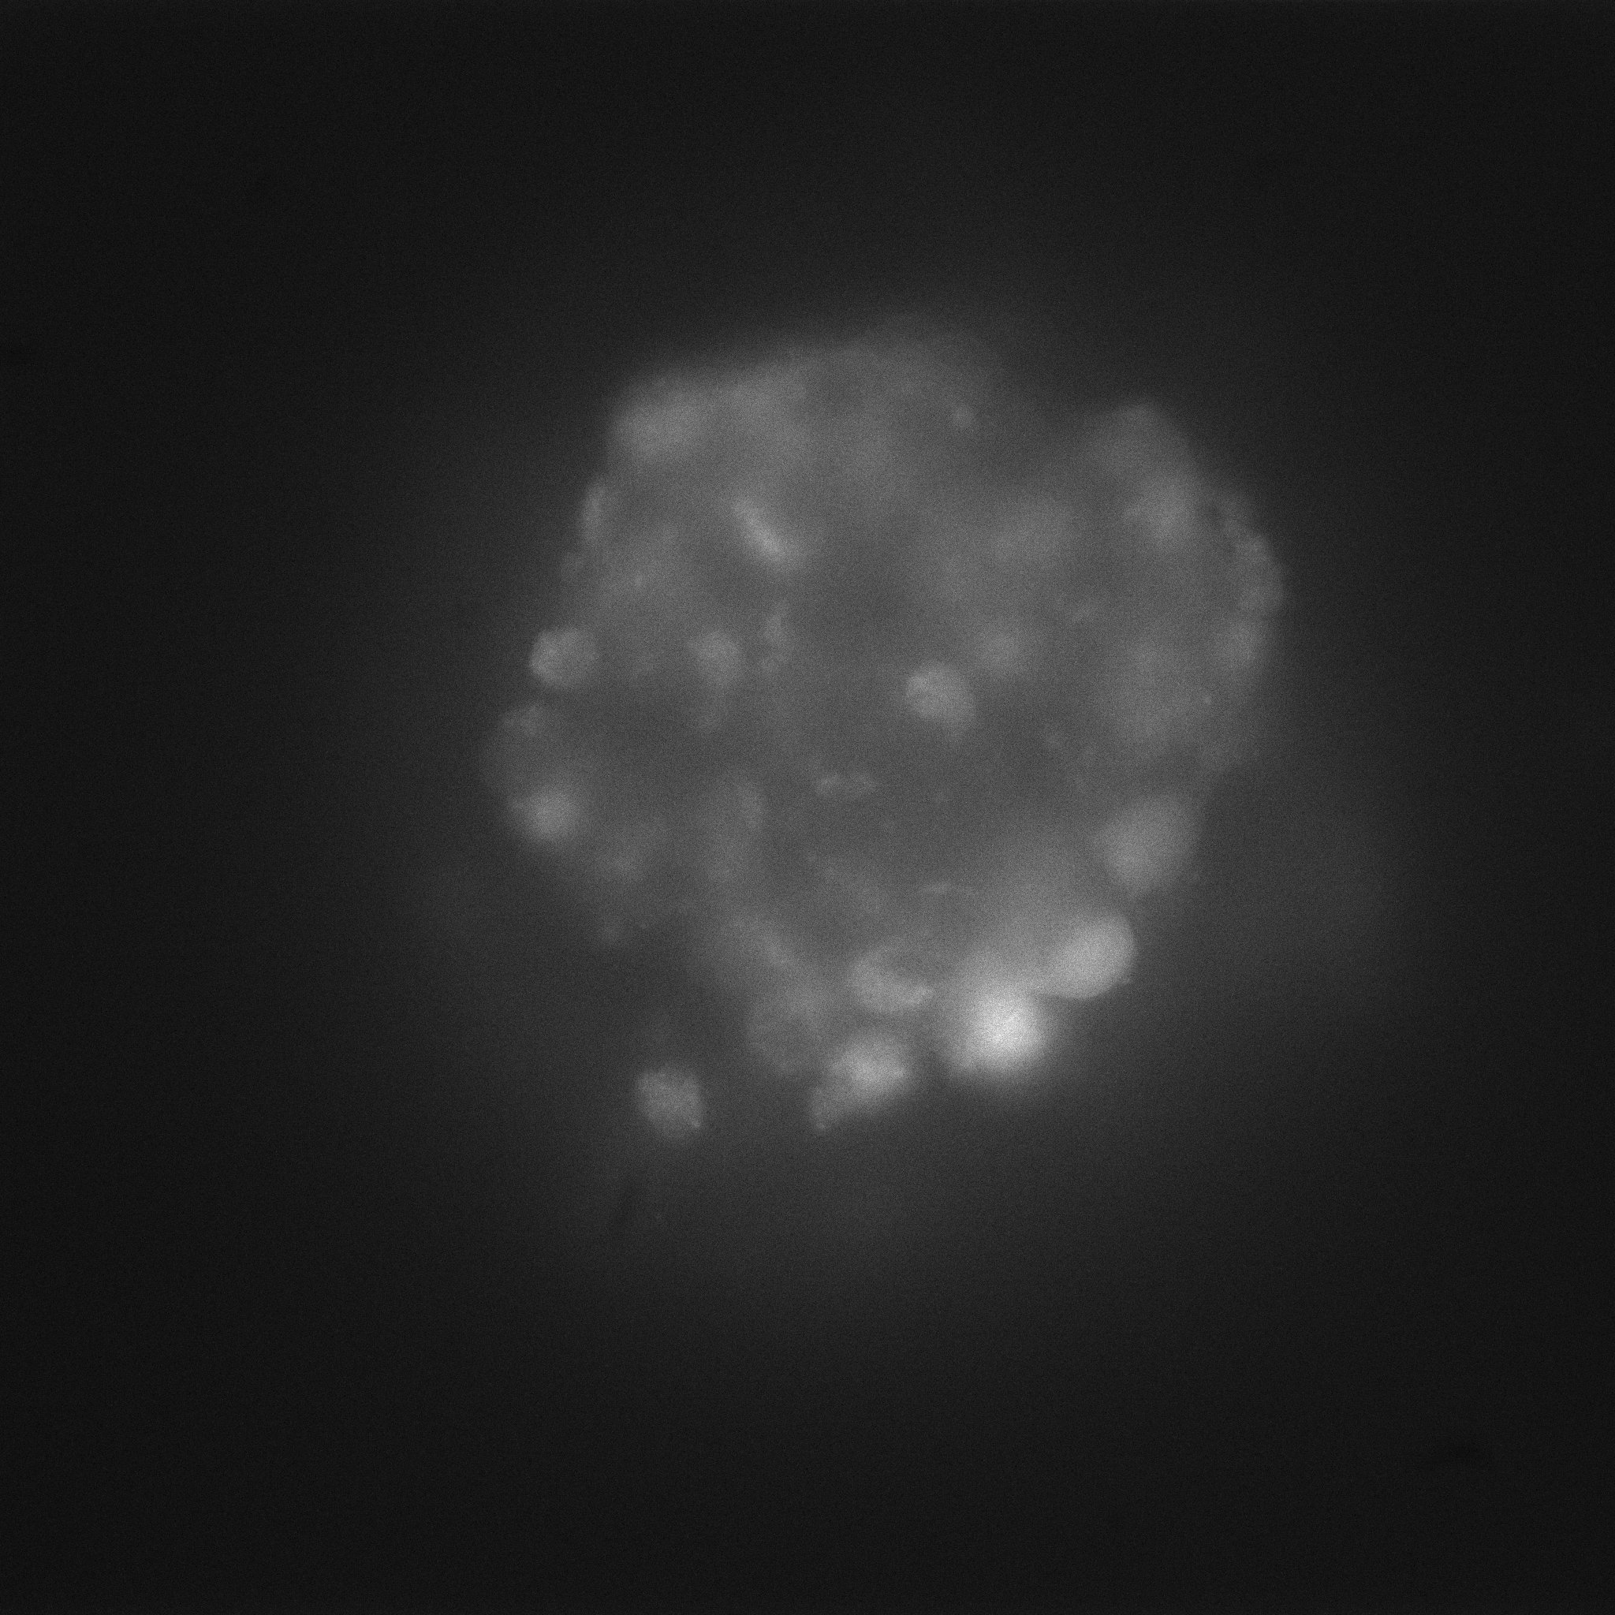
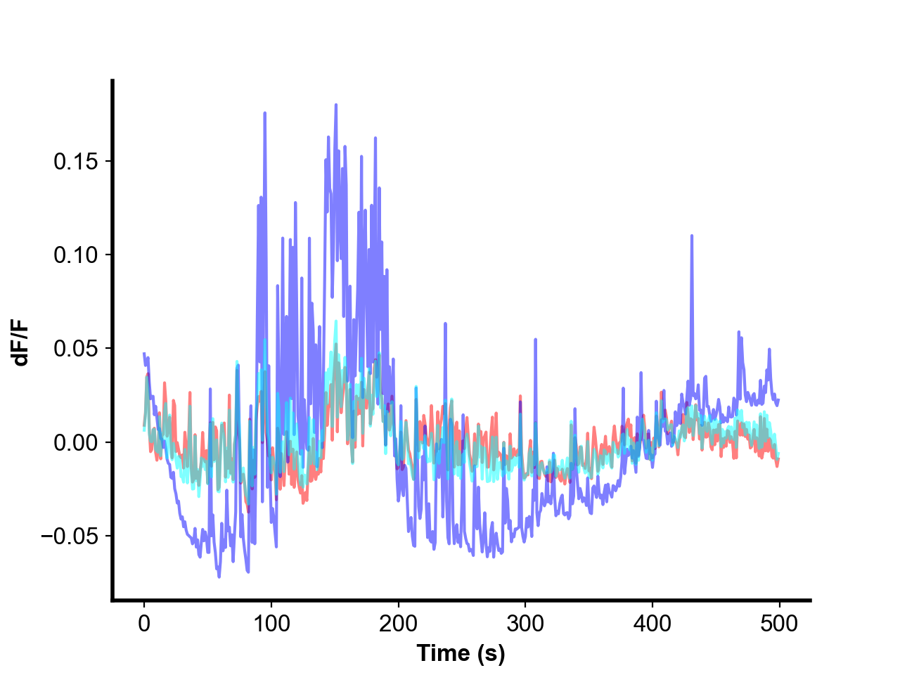
Monolayer
Pseudoislet
Notes:
`

